Slide 1
Management
Leonardo Iacovone / Javier Fernández

Slide 2
Management Score Colombia (Industry Edit 2018) vs. United States (Annual Survey of Manufactories 2010 and 2015)
Statistic (mean) | Colombia | USA
Management(1-16) | 0.37 | 0.61
No Incentives (1-8) | 0.55 | 0.64
Incentives (9-16) | 0.22 | 0.58
Size (Firm Employment) | 125.5 | 177
n | 6,034 | 31,793
Source: Iacovone / Fernández (2020) and Bloom (2019)

Slide 3
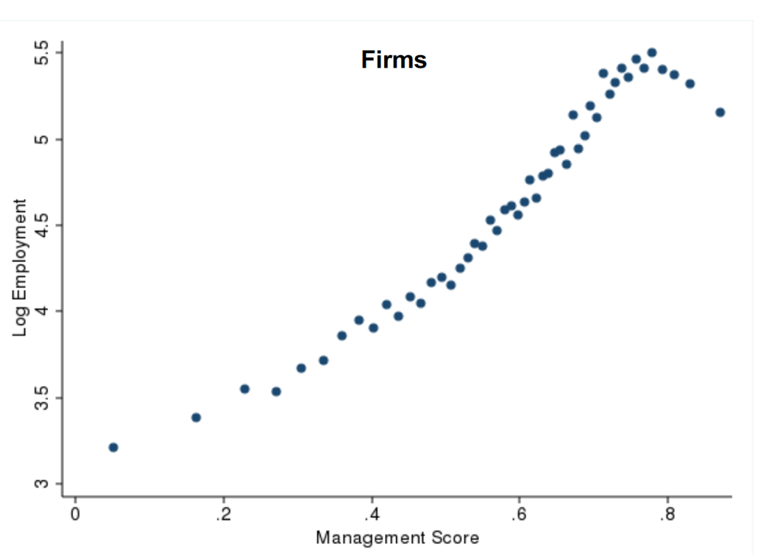
Employment and Management
Colombia
United States
Source: Iacovone / Fernández (2020)
Source: Bloom (2019)

Slide 4
Performance and Management
Performance measured by the average of:
Labor productivity
Exports,
Operating Profit
IP registers,
Wage per Employee,
Investment on Research, Development and Innovation.
Source: Iacovone / Fernández (2020)

Slide 5
Semi-elasticities of Colombia and United States Independent variable: Management
One standard deviation change in management
Coefficients
10% point-increase in management
Dependent Variable | Colombia | United States
Output / Emp | 0.24 | 0.209
Value Added / Emp | 0.64 | 0.498
R&D+i / Emp | 2.94 | 0.385
Exports | 2.92 | 0.37
Imports | 2.37 | 0.34
Dependent Variable | Colombia | United States
Output / Emp | 2.43% | 2.11%
Value Added / Emp | 6.61% | 5.11%
R&D+i / Emp | 34.18% | 3.93%
Exports | 33.91% | 3.77%
Imports | 26.74% | 3.46%
Dependent Variable | Colombia | United States
Output / Emp | 4.31% | 3.75%
Value Added / Emp | 11.92% | 9.16%
R&D+i / Emp | 67.77% | 7.01%
Exports | 67.18% | 6.73%
Imports | 51.76% | 6.17%
Source: Iacovone / Fernández (2020)

Slide 6
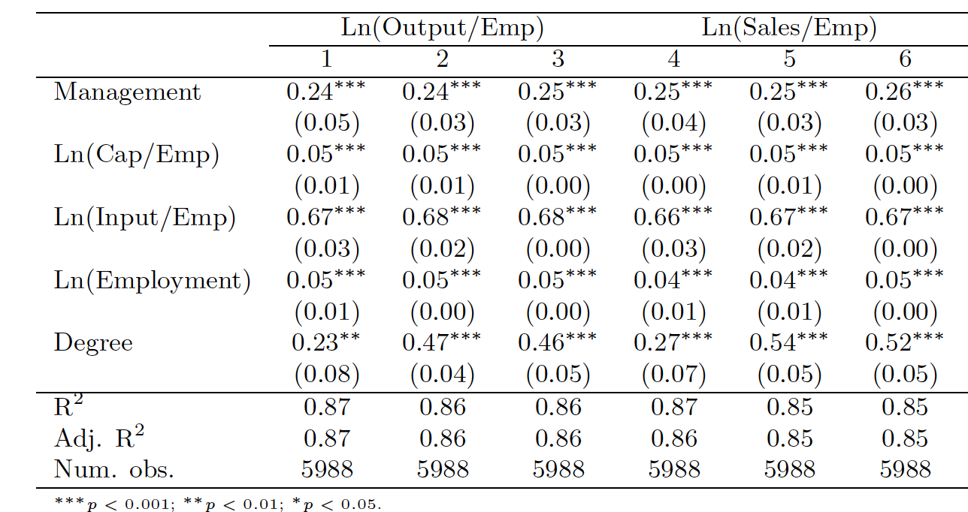
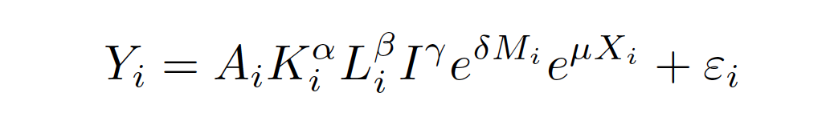
Firm Management Score and Performance (1)
Yi:Production of firm i
Ai: Total factor productivity (Excluding Management Practices)
Ki:Fixed assets at final of 2018
Li:Labor inputs: the total number of employees of firm i
Ii:Intermediate inputs
Xi:Vector of additional factors: the percent of staff with college degree
Mi: Management score (1-16)
Every 10%-point increase in our management score is associated with a 2.43% on Output / Emp
(= exp(0.24/10) − 1)=2.43%
One standard deviation change in management is associated with a 4.5% on Output / Emp
(=EXP(0.176*0.24)-1)=4.3%
Source: Iacovone / Fernández (2020)

Slide 7
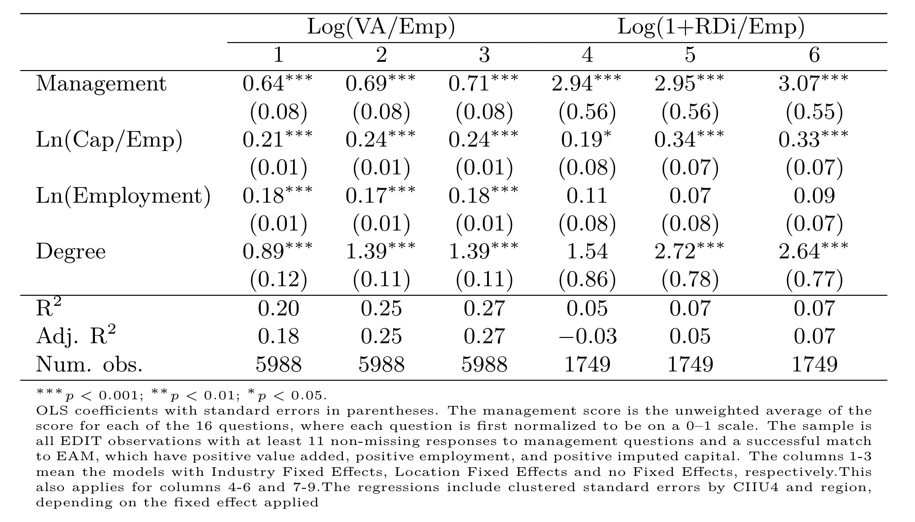
Firm Management Score and Performance (2)
Every 10%-point increase in our management score is associated with a 6.61% on VA / Emp
(= exp(0.64/10) − 1)=6.61%
Every 10%-point increase in our management score is associated with a 34.18% on R&Di / Emp
(=exp(0.176*2.94)-1)=34,1%
Source: Iacovone / Fernández (2020)

Slide 8
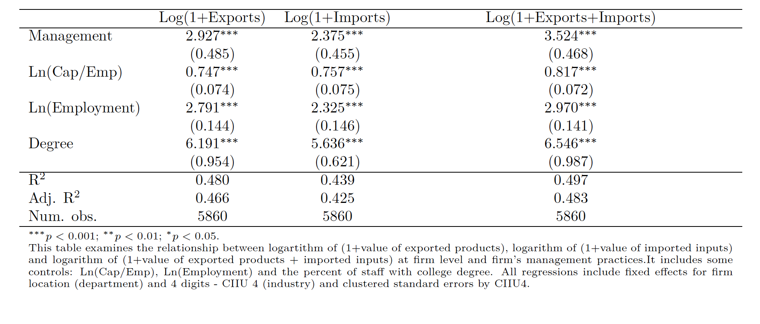
Trade Outcomes and Management
Every 10%-point increase in our management score is associated with a 33.9% on Exports
(= exp(2.92/10) − 1)=33.9%
Every 10%-point increase in our management score is associated with a 26.7% on Imports
(=exp(0.176*2.94)-1)=26,7%
Source: Iacovone / Fernández (2020)

Slide 9
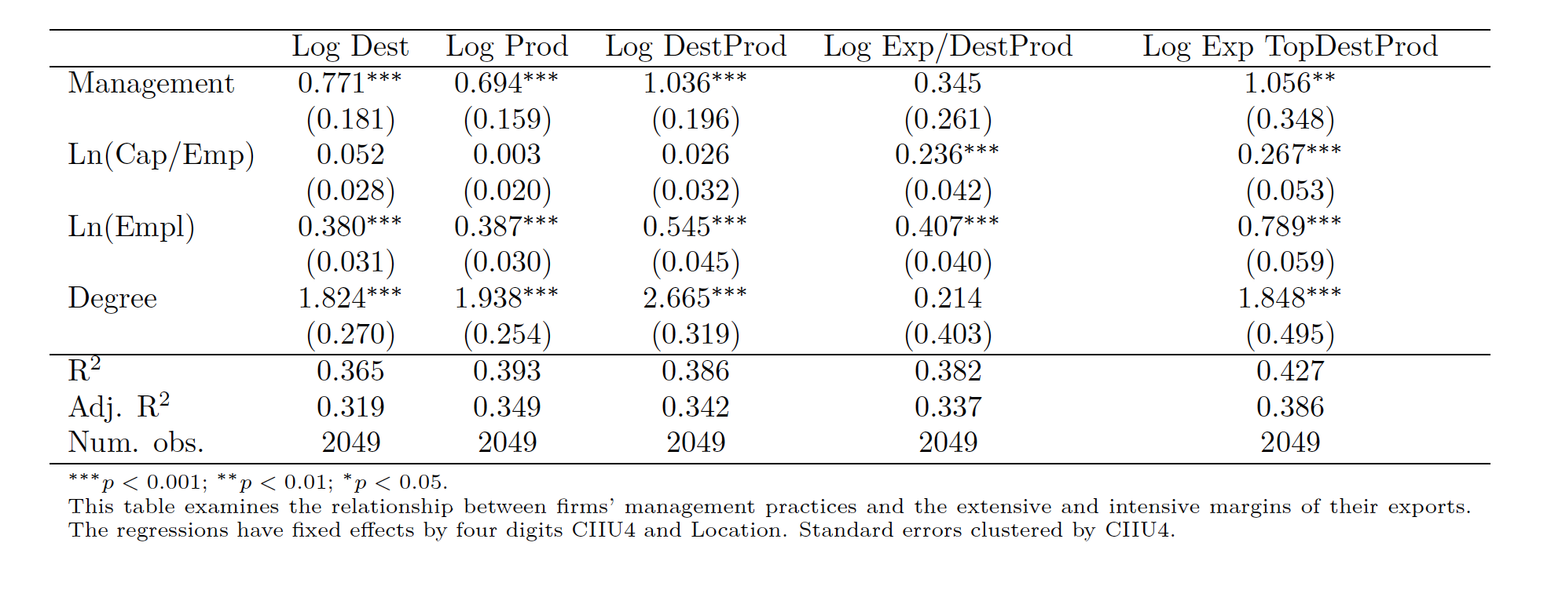
Extensive and Intensive Margins of Exports
Dest=Destinations: # export destinations measured by countries
Prod: Products: # products with 6 digits-HS codes
DestProd: # pairs of Destination-Product
Exp/DesProd: Export per Destination-Product
TopDestProd:The highest market(country) measured by export value.
Source: Iacovone / Fernández (2020) with data WMS-2015

Slide 10
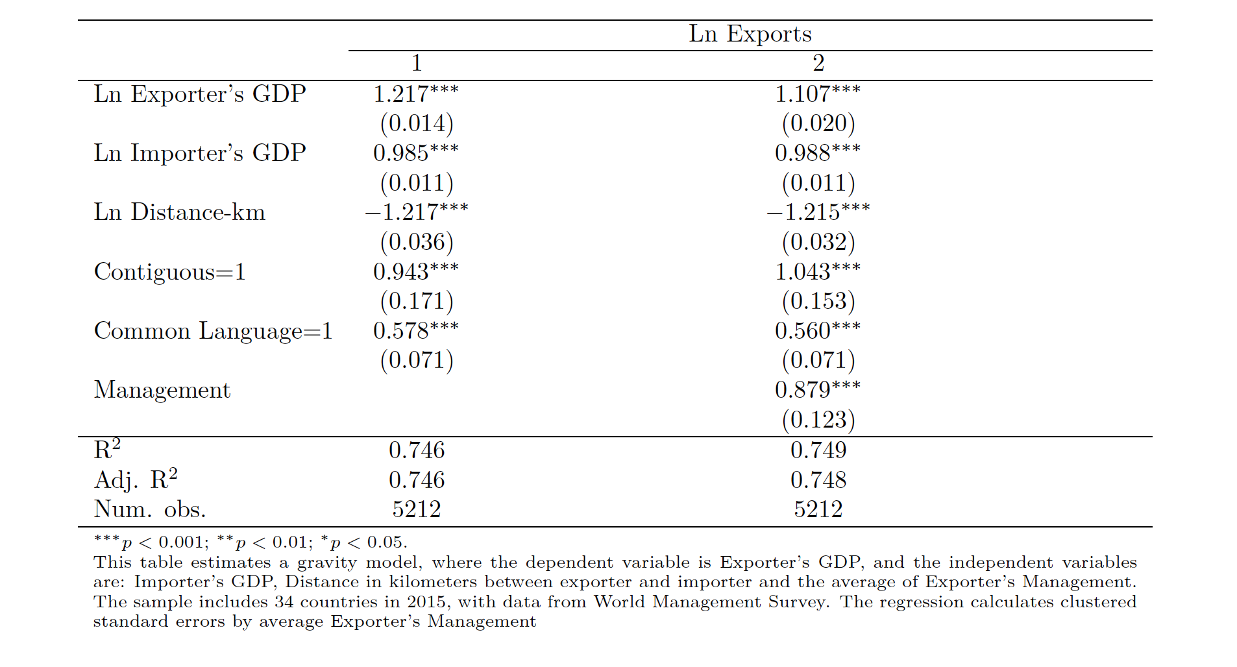
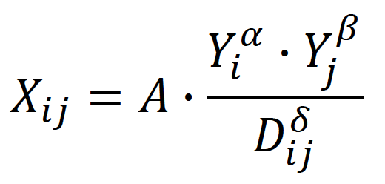
Gravity Equation and Management
X_{ij} : Exports from i to j
Y_{i} : i’s GDP
D_{ij} : Geographical distance between countries i and j
Positive Sign of Management
Source: Iacovone / Fernández (2020) with data WMS-2015

Slide 11
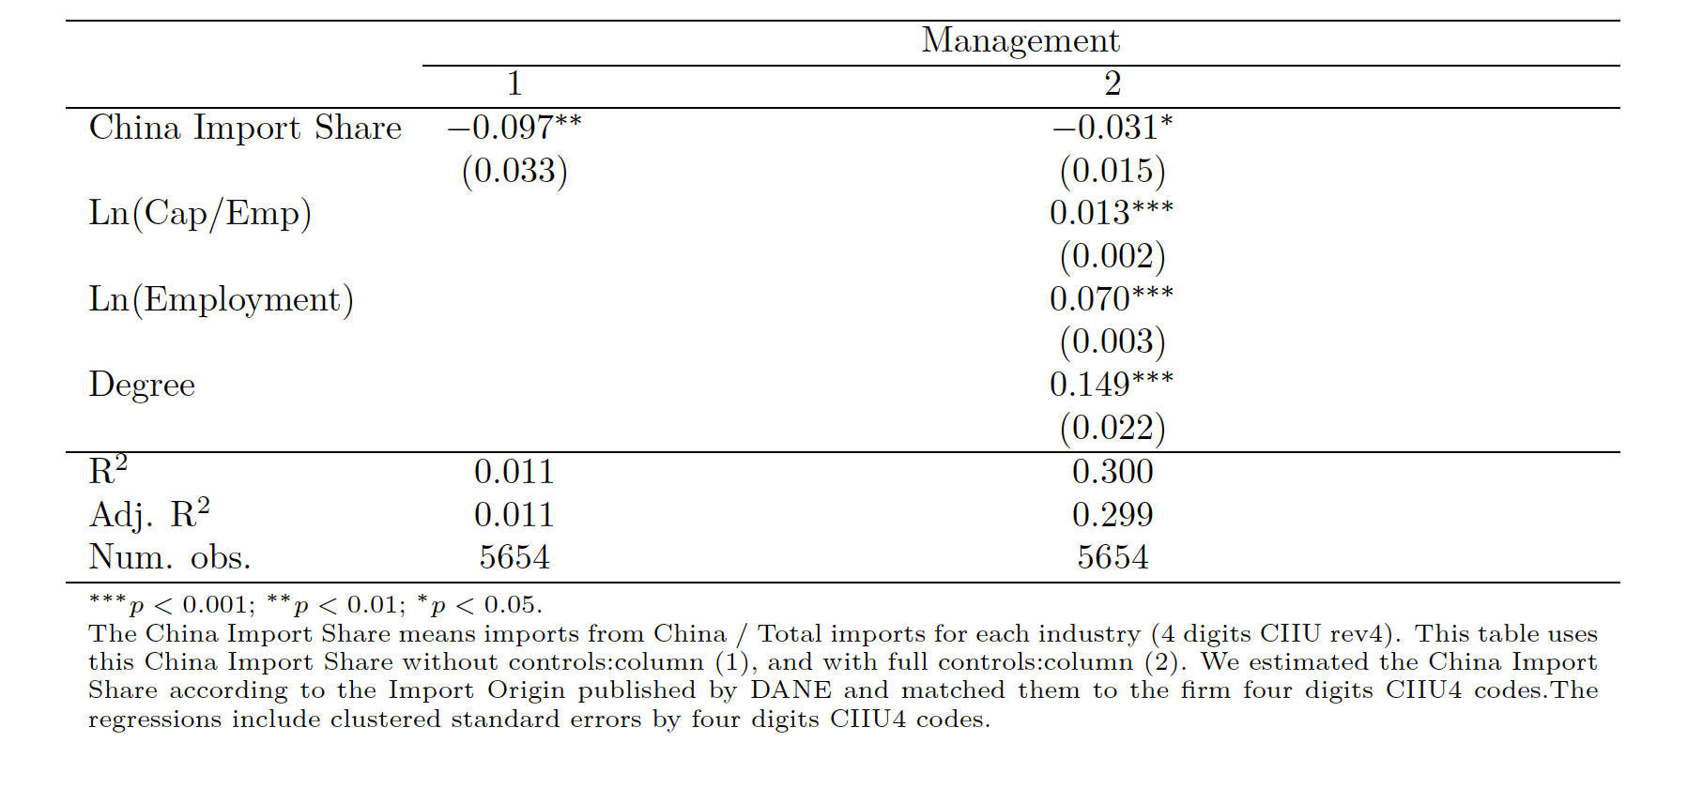
China Import Share and Management
Chinese Import Share is a variable of competitive pressure, which indicates a negative sign.
Source: Iacovone / Fernández (2020)

Slide 12
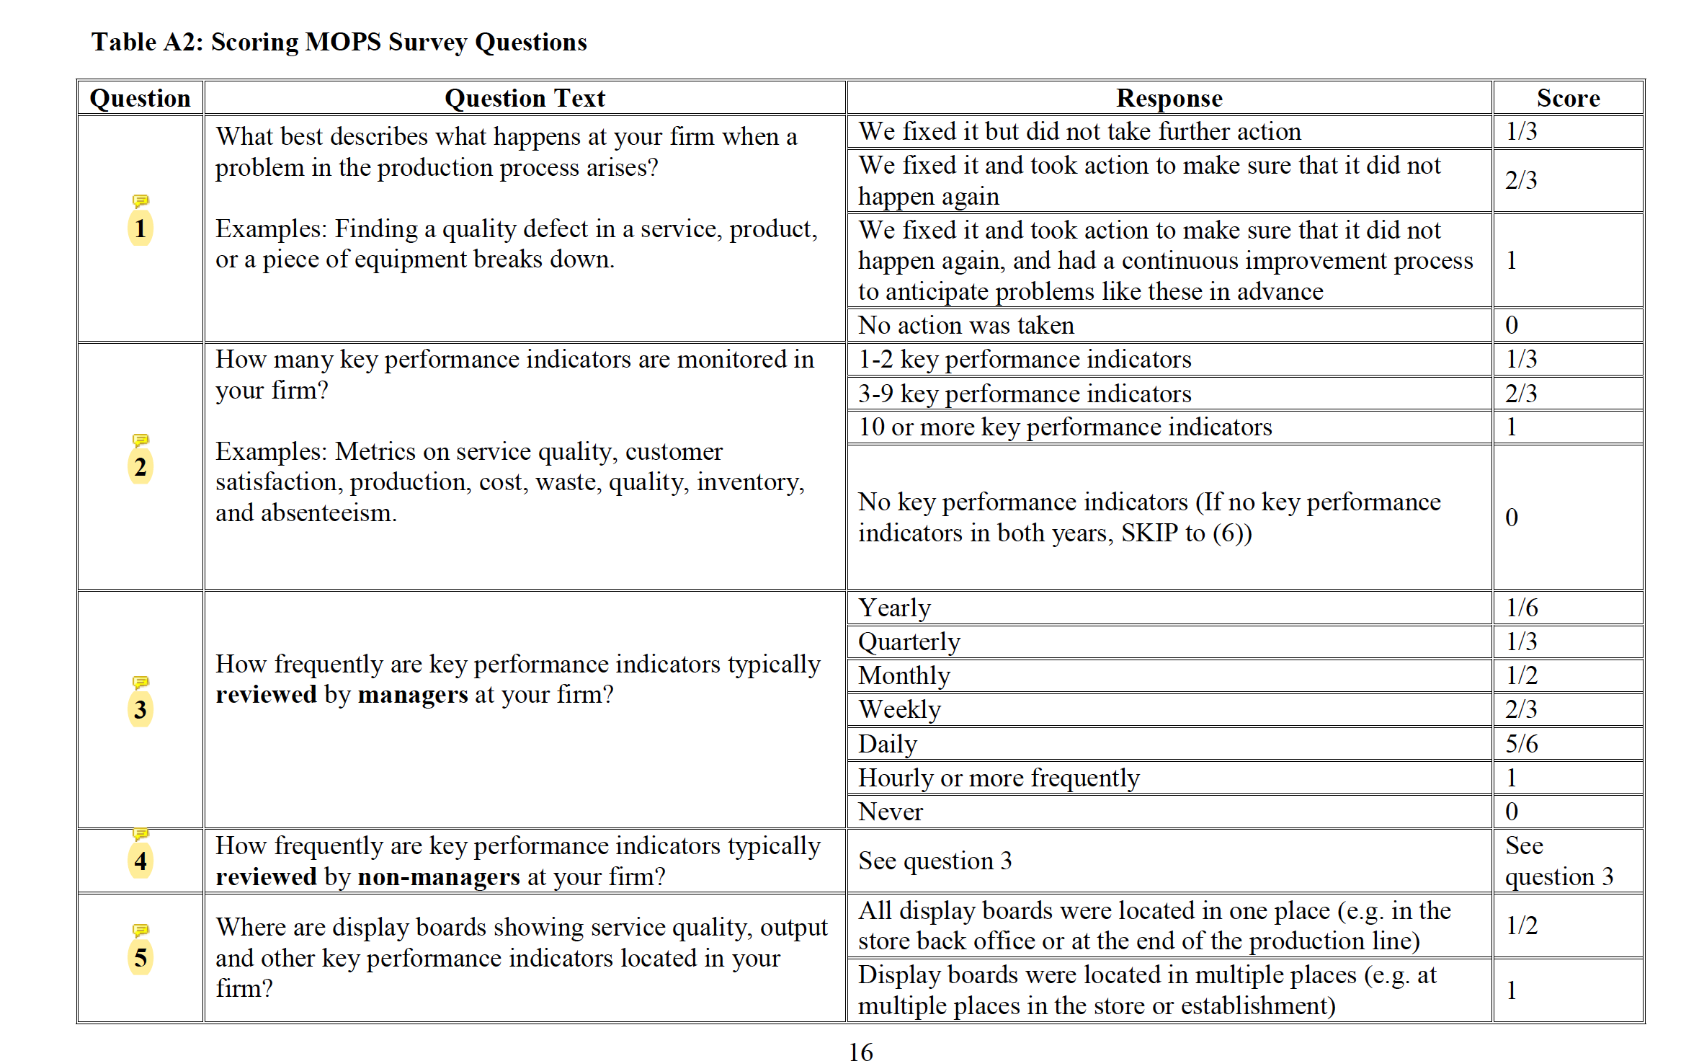
Scoring MOPS Survey Questions

Slide 13
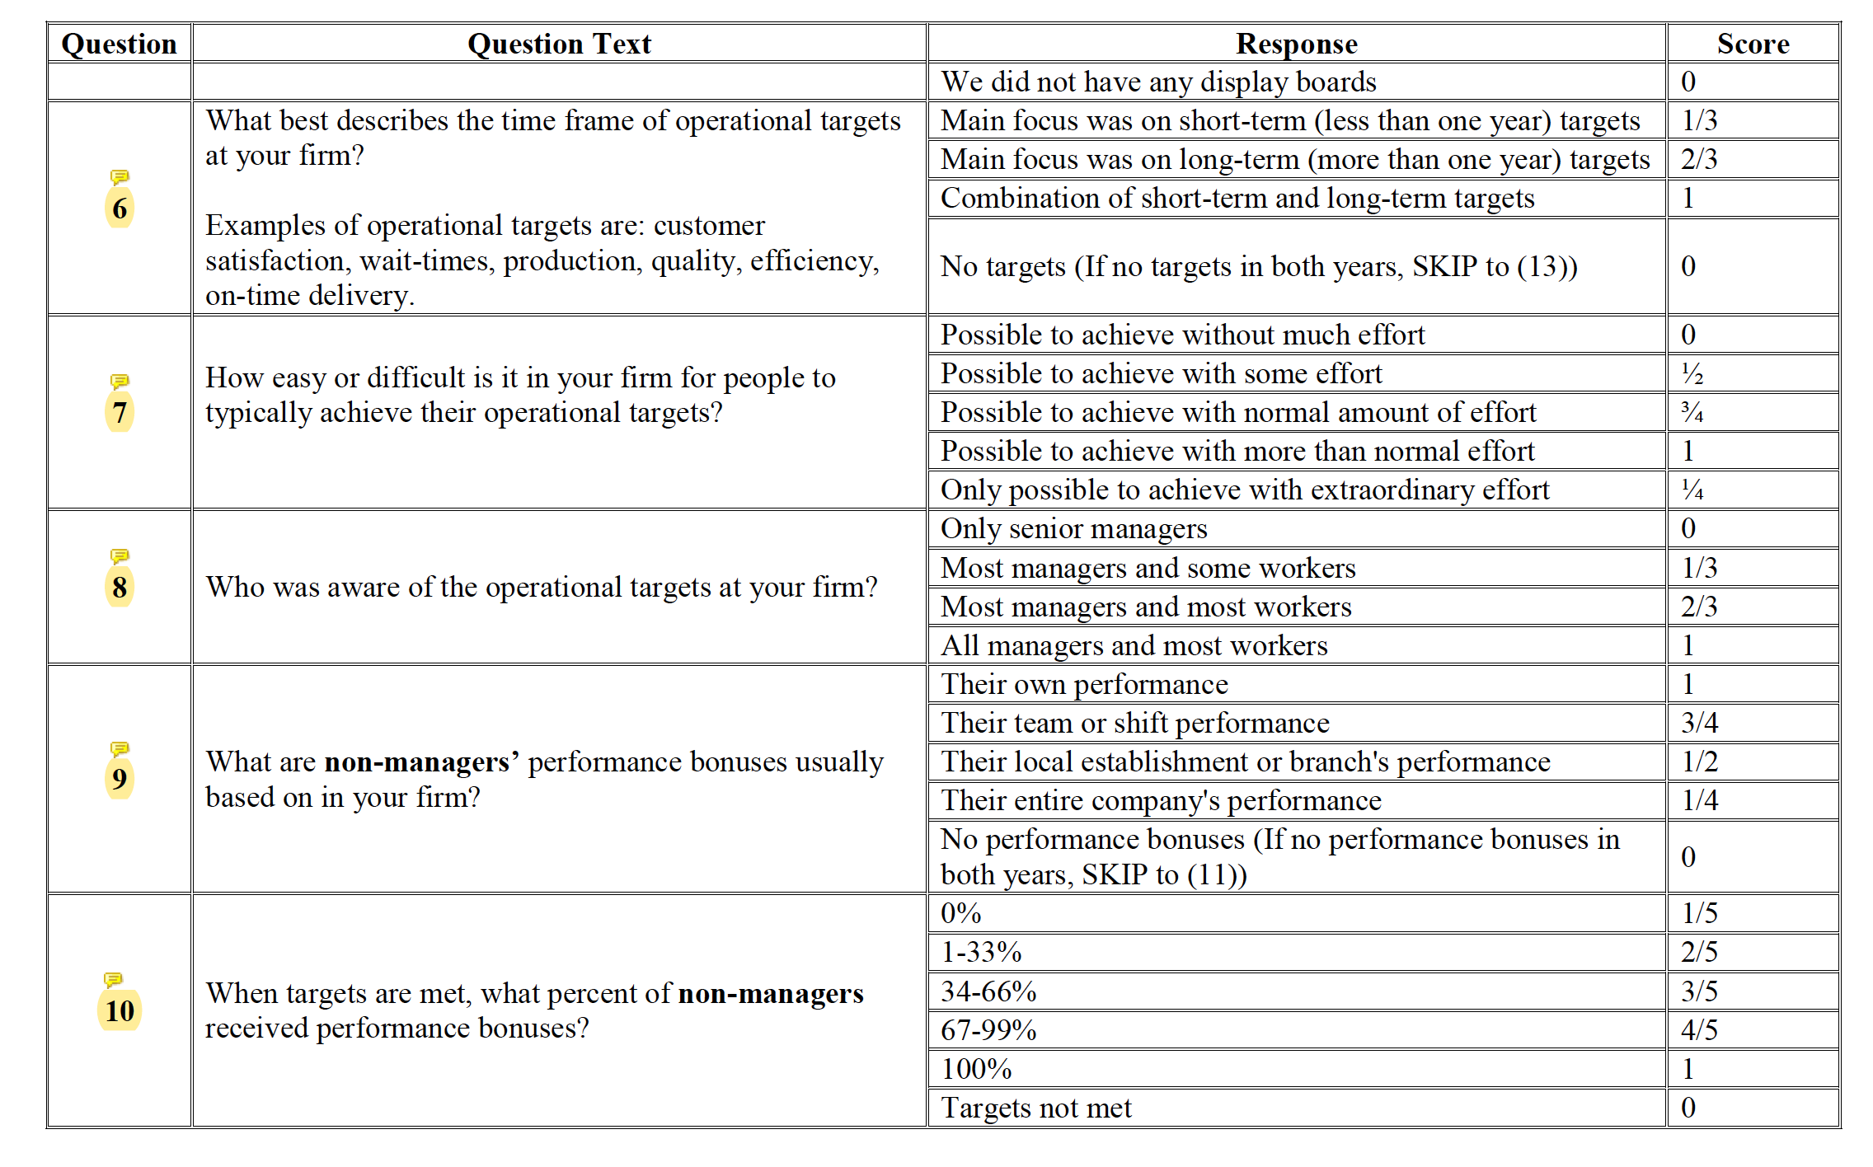
Scoring MOPS Survey Questions

Slide 14
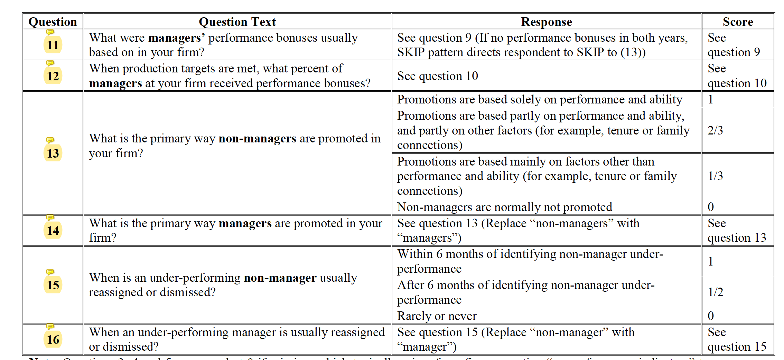
Scoring MOPS Survey Questions

